Slide 1
Akash Kavale
DT Mart Sales Dashboard

Slide 2
Contents
Introduction to Data
Report
Objective
Data Insights
Final Conclusion

Slide 3
Introduction
We have used the data of Dt Mart Sales Analytics project. The data related to sales performance, potentially for a retail company. This data includes the information about Order Date, Order Priority Ship Type, City, State, Country, Region, Segment Super Category, Category, Price, Operational/ Production Cost, Selling Price, Discount Shipping Cost, Sales (shipping price included) ,Profit, Quantity, profit per item.

Slide 4
Objective
Enhance Order Processing Efficiency:
Analyze fulfillment time based on Order Priority and Ship Type.
Identify cost-effective shipping methods without compromising delivery speed.
Gain Customer Insights:
Understand customer demographics and buying patterns based on location and Segment Super Category.
Identify potential growth markets and tailor marketing strategies for specific customer segments.
Optimize Profitability and Pricing:
Analyze profit margins for each product category to identify high and low performers.
Explore the relationship between Price, Discount, Quantity sold, and Profit to determine optimal pricing strategies.
Identify Sales Drivers and Growth Opportunities:
Discover key factors influencing sales volume, such as price elasticity and marketing effectiveness (if data available).
Identify high-growth categories and products with potential for upselling or cross-selling.
-

Slide 5
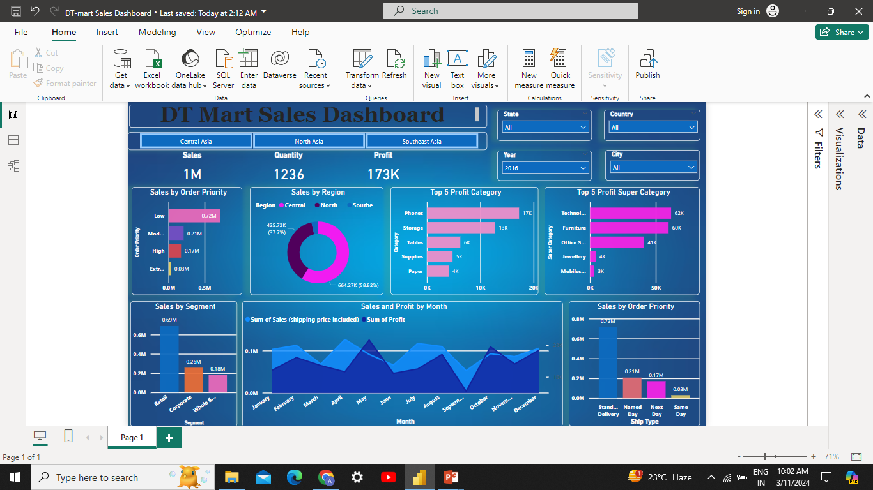
Dashboard

Slide 6
High Priority orders might contribute the most to overall sales, but further analysis is needed to assess fulfillment efficiency for each priority level. Central Asia appears to have significantly lower sales compared to North and Southeast Asia. Phones and Chairs seem to be top 3\contributors to overall profit, but profitability analysis for all categories might be necessary. The line chart (Sales and Profit by Month) might suggest seasonal trends, requiring further exploration with time-based filters.
Data Insights

Slide 7
1. Overall, sales seem healthy, but there might be ways to improve efficiency in some areas, like order fulfillment and customer targeting in Central Asia. 2.High priority orders seem to contribute most to total sales, but fulfillment efficiency by priority level remains unclear. 3.Ensure high-priority orders are fulfilled quickly to meet customer expectations. 4.Analyze customer purchases to recommend complementary products and potentially increase revenue per customer.
Final Conclusions

